Slide 1


Update for NCCOC Meeting, 19 Jan 2019
Wilsbach and Graham

Slide 2
4th Branch Update
______ total registered for 4thbranchnc.org website.
Chapter Presidents report status of encouraging members to register.
Graham recommended securing attorney involvement. Small group met with Phillip Isley who will have report before 12 Feb. mtg.
Lobbyist reviewed MOAA article after interview with Graham and Cansler re: NC taxation issues.
Two sided “rack card” available digitally and hard copy. Potential for bookmark size as well.
Still need Chapter input for poster pictures.
Planning for Legislative Day in March.
NC General Assembly – committee formation. Bill co-sponsors needed. Stay tuned for details.

Slide 3
NCCOC – Advocacy at Federal & State Levels
MOAA
Review of 2019 Key Legislative Goals
Graham addressed concern about CALLS TO ACTION potentially being
Hidden in MOAA Newsletter. Must be vigilant in reading and responding.
Preparations for Storming the Hill started many months ago. Building blocks in place.
NC Team is very important to National MOAA.
State Advocacy
NCCOC has great potential for making a difference due to our local relationships.
Steps – Identify those important bills that did not get thru process last session but need to be re-introduced.
DMVA helping us to identify their priorities. Guard /Res also have priorities.

Slide 4
State Level Advocacy
Not able to determine efforts to date by NC Veterans Council.
Input from your county Veterans Councils.
DSLO Program – Regional Director is Kevin Bruch. Has worked with many legislators and Graham at NCVC. He has identified legislative needs to meet DSLO goals. He can meet with us when he travels to NC. See DSLO goals for NC and Tracker.
Suggest as Council, we:
review and prioritize efforts
, finalize operational plan
provide sample letters to legislators
Telcons to tract progress
All sign up for General Assembly emails
Promote Legislation business is everyone’s business – just like RECRUITING!!!!

Slide 5
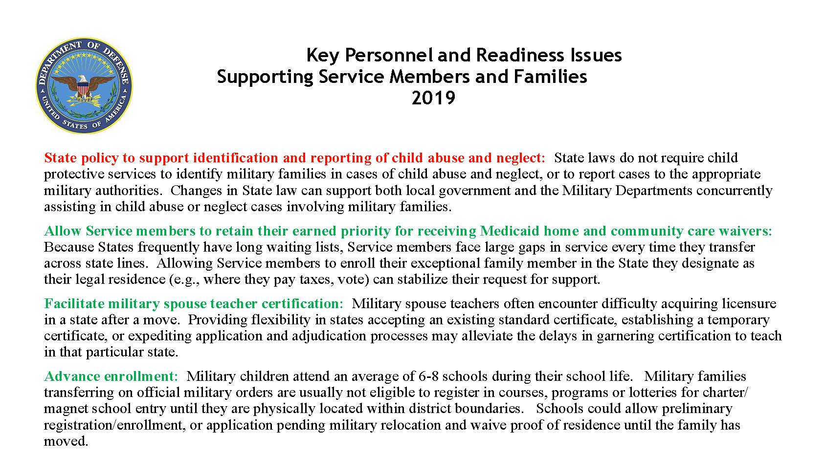

Slide 6
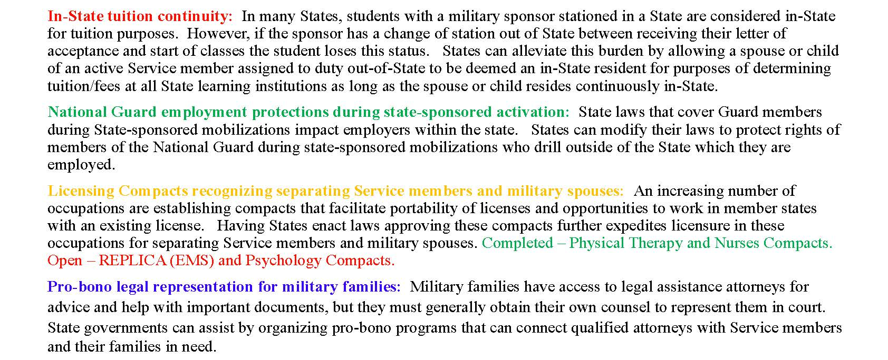

Slide 7
